Slide 1
Using JCache
JCache
Greg luck, co-SPEC LEAD jsr107 @gregrluck
CEO | Hazelcast
28 November 2015

Slide 2
Agenda
Introduction to Caching
Java Caching (JCache), JSR-107
Code Demo

Slide 3
Introduction to Caching

Slide 4
Benefits of Caching
Performance
Offload expensive or non-scalable parts of your architecture
Scale up – get the most out of one machine
Scale out – add more capacity with more machines
Excellent Buffer against load variability
And…
Usually very fast and easy to apply
Notes:
Caching as a solution automatically provides speed. And a distributed cache provides scale out.

Slide 5
When to Use Caching
When applications use the same data more than once
When cost (time / resources) of making an initial copy is less than fetching or producing the data again or when faster to request from a Cache
Notes:
Caching as a solution automatically provides speed. And a distributed cache provides scale out.

Slide 6


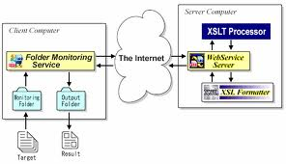
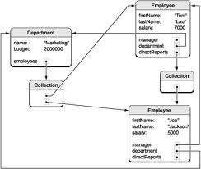

Common Problem Areas that Benefit
Anything Web Scale
Anything where the data is across the network
1
3
Compound Data Objects
Data Persistence
2
4
Notes:
Most Amdahl’s Law analyses will turn up the following bottlenecks:
Web: static content (solved by edge caches such as Akamai, Limelight, CloudFront), origin page caching and page fragment caching. e.g. Can be hundreds of DB lookups to build up a page
Collections Caching: Storing precomputed or transformed results. E.g. hotels in a region
External Systems: Web services,
Data: Data Stores

Slide 7

Database Caching
Application
Application
Application
Application
Cache
Cache
Cache
Cache
~200 us
Data Store
Average Response Time
Speed
✓
Costs
✓
Scalability
✓
Moving data from the database into the cache increases processing speed and can reduce database licensing and maintenance costs.

Slide 8
Caches are built primarily in RAM in-process or distributed
Latency)
Local Storage
Size (GB)
<100 ns
Heap (Objects)
2
Opaque to GC in RAM (serialized form)
< 100ns +deserialization time
500
Flash/SSD (serialized form)
< 50us +deserialitzation time
1,000+
< 140us for 1Gbps < 70us for 10Gbps/40Gbps +deserialitzation time
Scaleout across the network (serialized form)
20,000+
Network Storage
Notes:
But in Ehcache you should be always able to fit what you need to in cache.
Even beyond the limits of local storage, the partitioned cache available with Terracotta Server Array takes you into the terabytes.
And the speeds shown are worst case. The average for a given cache will heavily favour the highest points of the pyramid.
Overall throughput is scaleable by increasing threads, cpus and nodes.

Slide 9

Estimated Performance Improvements
‘s law
Predicted System Speedup
=
1 / ((1 – Proportion Sped Up) + Proportion Sped Up / Speed up))
Notes:
Amdahl's law, after Gene Amdahl, is used to find the system speed up from a speed up in part of the system. 1 / ((1 - Proportion Sped Up) + Proportion Sped Up / Speed up)To apply Amdahl’s law you must measure the components of system time and the before and after affect of the perf change made. It is thus an empirical approach.

Slide 10
Cache Efficiency
= cache hits / total hits
High efficiency = high offload
High efficiency = high performance
How to increase:
Put reference data in the cache
Put long lived in the cache.
Consider frequency of mutability of data
Put highly used data in cache
Increase the size of the cache. Today you can create TB sized caches
10
Notes:
Two reasons for poor performance:
What if the data set is too large to fit in the cache?
What about limiting time to live due to concerns around staleness of data i.e. incoherence with the underlying SOR

Slide 11
Problems to Consider
Standalone Caches and the N * problem
As each entry expires, the backing system gets N requests for data where n is the number of standalone caches. Solution: Use a distributed cache
Consistency with the System of Record
How to keep the cache in sync with changes in a backing system. Solution: Match mutability of data with data safety configuration. Update the cache and backing store at the same time.
Consistency with other cache nodes
How to keep all cache nodes in sync: Solution: Use a distributed cache and match consistency configuration with data mutability
11
Notes:
Two reasons for poor performance:
What if the data set is too large to fit in the cache?
What about limiting time to live due to concerns around staleness of data i.e. incoherence with the underlying SOR

Slide 12
Java Caching (JCache)

Slide 13
Java Caching (JCache)
What?
Java Caching (JCache) standardized Caching for the Java Platform*
A common mechanism to create, access, update and remove information from Caches
How?
JSR-107: Java Caching Specification (JCache)
Java Community Process (JCP) 2.9

Slide 14
Java Caching (JCache)
Why?
Standardize! Standardize! Standardize!
Core Caching Concepts
Core Caching API
Provide application portability between Caching solutions
Big & Small, Open & Commercial
Caching is ubiquitous!

Slide 15
Java Caching (Jcache)
When?
Here Now!
Item | Date
JCache Final Spec Released | 18 March 2014
Spring 4.1 | September 2014
Hazelcast 3.3.1 TCK Compliant | September 2014
Hazelcast 3.4 (with High-Density Memory Store) | November 2014
Hazelcast 3.6 (with High-Density Caching) | July 2015

Slide 16

Implementations
Implementations
JCache Reference Implementation
Hazelcast
Oracle Coherence
Terracotta Ehcache
Infinispan
GridGain
TayzGrid
Keep Track
https://jcp.org/aboutJava/communityprocess/implementations/jsr107/index.html

Slide 17
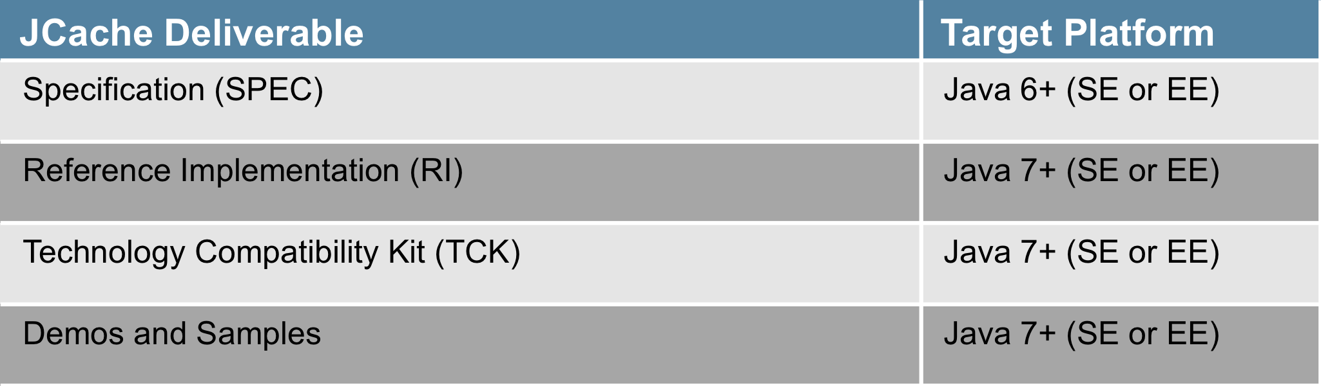
Java Caching (JCache)
Which Platform?

Slide 18
Java Caching (JCache)
Project Hosting
JCP Project:
http://jcp.org/en/jsr/detail?id=107
Source Code:
https://github.com/jsr107
Forum:
https://groups.google.com/forum/?fromgroups#!forum/jsr107

Slide 19
Java Caching (JCache)
How to get it.
Apache Maven: (via Maven Central Repository)
<dependency>
<groupId>javax.cache</groupId>
<artifactId>cache-api</artifactId>
<version>1.0</version>
</dependency>

Slide 20
Caches and Caching

Slide 21
Caches and Caching
JSR107 Cache Definition: A high-performance, low-latency data-structure* in which an application places a temporary copy of information that is likely to be used more than once

Slide 22
Maps vs Cache APIs
java.util.Map (Java 6/7)
Key-Value Based API
Supports Atomic Updates
Entries Don’t Expire
Entries Aren’t Evicted
Entries Stored On-Heap
Store-By-Reference
javax.cache.Cache (Java 6)
Key-Value Based API
Supports Atomic Updates
Entries May Expire
Entries May Be Evicted
Entries Stored Anywhere (ie: topologies)
Store-By-Value and Store-By-Reference
Supports Integration (ie: Loaders / Writers)
Supports Observation (ie: Listeners)
Entry Processors
Statistics
Notes:
Perhaps ask who is using Java 6?
Note that we’re comparing to Java 6/7 java.lang.Map, not Java 8.

Slide 23
JCache: Features
java.util.ConcurrentMap like API
Atomic Operations
Lock-Free
Read-Through / Write-Through Integration Support
Cache Event Listeners
Fully Generic API = type-safety
Statistics
Annotations (for frameworks and containers)
Store-By-Value semantics (optional store-by-reference)

Slide 24
JCache: Features
Topology Agnostic
Topologies not defined or restricted by the specification
Efficiently supports:
“local” in-memory Caching and
“distributed” server-based Caching

Slide 25
JCache Key Classes/Interfaces

Slide 26
JCache: Runtime Structure
Caching “service loader”
“application”
Loads & Tracks
*
CachingProvider “SPI implementation”
Uses..
*
Created
& Managed By
CacheManager “manager of caches”
*
*
Created
& Managed By
Cache “interface to a Cache”

Slide 27
JCache: Cache Managers
javax.cache.CacheManager
Establishes, configures, manages and owns named Caches
Caches may be pre-define or dynamically created at runtime
Provides Cache infrastructure and resources
Provides Cache “scoping” (say in a Cluster)
Provides Cache ClassLoaders (important for store-by-value)
Provides Cache lifecycle management

Slide 28
JCache: Hello World
(via a Cache Manager)
// acquire the default CacheManager
CacheManager manager = Caching.getCacheManager();
// acquire a previously configured cache (via CacheManager)
Cache<Integer, String> cache = manager.getCache(“my-cache”, Integer.class, String.class);
// put something in the cache
cache.put(123, “Hello World”);
// get something from the cache
String message = cache.get(123);

Slide 29
Cache Interface & Methods (in IDE)

Slide 30
JCache: Entry Processors
(custom atomic operations for everyone!)
// acquire a cache
Cache<String, Integer> cache =
manager.getCache(“my-cache”, String.class, Integer.class);
// increment a cached value by 42, returning the old value
int value = cache.invoke(“key”, new IncrementProcessor<>(), 42);

Slide 31
JCache: Entry Processors
(custom atomic operations for everyone!)
public class IncrementProcessor<K> implements EntryProcessor<K, Integer, Integer>, Serializable {
@Override public Integer process(MutableEntry<K, Integer> entry, Object... arguments) {
if (entry.exists()) {
int amount = arguments.length == 0 ? 1 : (Integer)arguments[0];
int current = entry.getValue();
entry.setValue(count + amount);
return current;
} else { throw new IllegalStateException(“no entry exists”); } }

Slide 32
JCache: Entry Processors
(custom atomic operations for everyone!)
Eliminate Round-Trips! (in distributed systems)
Enable development of a Lock-Free API! (simplifies applications)
*May need to be Serializable (in distributed systems)
Application
Application
Cache
Cache

Slide 33
JCache: Entry Processors
Java 8 Ready!
Which is better?
// using an entry processor?
int value = cache.invoke(“key”, new IncrementProcessor<>(), 42);
// using a lock based API?
cache.lock(“key”);
int current = cache.get(“key”);
cache.put(“key”, current + 42);
cache.unlock(“key”);

Slide 34
Annotations
JSR107 introduces a standardized set of caching annotations, which do method level caching interception on annotated classes running in dependency injection containers.
Caching annotations are becoming increasingly popular:
Ehcache Annotations for Spring
Spring 3’s caching annotations.
JSR107 Annotations will be added to:
Java EE 8 (planned?)
Spring 4.1 (released)

Slide 35
Annotation Operations
The JSR107 annotations cover the most common cache operations:
@CacheResult
@CachePut
@CacheRemove
@CacheRemoveAll

Slide 36
Fully Annotated Class Example
@CacheDefaults(cacheName = "blogManager")
public class BlogManager {
@CacheResult
public Blog getBlogEntry(String title) {...}
@CacheRemove
public void removeBlogEntry(String title) {...}
@CacheRemoveAll
public void removeAllBlogs() {...}
@CachePut
public void createEntry(@CacheKey String title, @CacheValue Blog blog) {...}
@CacheResult
public Blog getEntryCached(String randomArg, @CacheKey String title){...}
}

Slide 37
Specific Overrides
public class DomainDao {
@CachePut(cacheName="domainCache")
public void updateDomain(String domainId,
@CacheKey int index,
@CacheValue Domain domain) {
...
}
}

Slide 38
The Future?
JCache 1.1 (2015)
Maintenance Release being worked on
JCache 2.0 (2016-)
Java 8 Language Features (Lambda & Streams)
Servlet 4.0 Integration / Session Caching?
Java EE 8 Alignment?
JCache 3.0 (2017?)
Java 10 Language Features?

Slide 39
Working with Hazelcast JCache

Slide 40
Hazelcast JCache Support
Full implementation for:
Hazelcast.newHazelcastInstance()
HazelcastClient.newHazelcastClient()
TCK Compliant
JCache with Hi-Density Memory Store
Docs: http://docs.hazelcast.org/docs/latest-dev/manual/html-single/hazelcast-documentation.html#jcache-overview

Slide 41
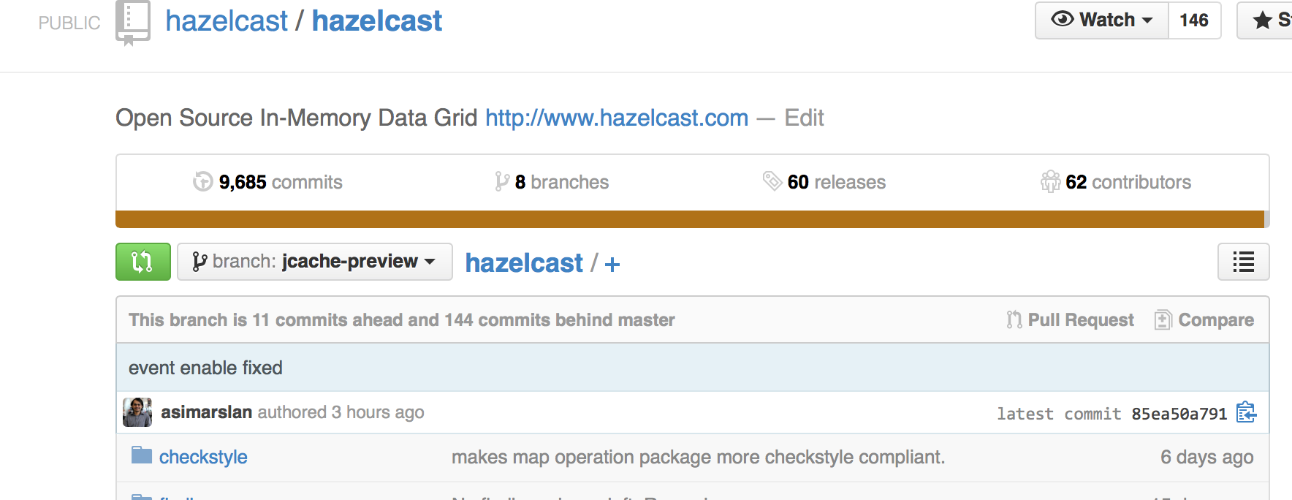
Check Out Hazelcast

Slide 42
Or Download
Download from hazelcast.org/download
Maven:
<dependency>
<groupId>com.hazelcast</groupId>
<artifactId>hazelcast</artifactId>
<version>3.5.4</version>
</dependency>

Slide 43
Questions?
Greg Luck
(@gregrluck)
greg@hazelcast.com
Terry Walters
(@tmwal7ers)
terry@hazelcast.com

